Slide 1

COMPUTER NETWORKS
Sivaraman Eswaran Ph.D.
Department of Computer Science and Engineering

Slide 2

COMPUTER NETWORKS
Application Layer
Sivaraman Eswaran Ph.D.
Department of Computer Science and Engineering

Slide 3
COMPUTER NETWORKS
Unit – 2 Application Layer
2.1 Principles of Network Applications
2.2 Web, HTTP and HTTPS
2.3 The Domain Name System
2.4 P2P Applications
2.5 Socket Programming with TCP & UDP
2.6 Other Application Layer Protocols

Slide 4
COMPUTER NETWORKS
Socket programming with TCP
Client must contact server
server process must first be running
server must have created socket (door) that welcomes client’s contact
Client contacts server by:
Creating TCP socket, specifying IP address, port number of server process
when client creates socket: client TCP establishes connection to server TCP
when contacted by client, server TCP creates new socket for server process to communicate with that particular client
allows server to talk with multiple clients
source port numbers used to distinguish clients (more in Chap 3)
Application viewpoint
TCP provides reliable, in-order
byte-stream transfer (“pipe”)
between client and server

Slide 5
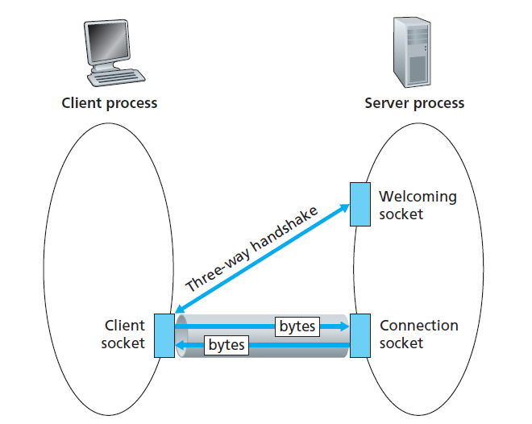
COMPUTER NETWORKS
The TCPServer Process has Two Sockets

Slide 6

COMPUTER NETWORKS
Client/server socket interaction: TCP
server (running on hostid)
client
create socket,
port=x, for incoming request:
serverSocket = socket()
wait for incoming
connection request
TCP
connection setup
create socket,
connect to hostid, port=x
connectionSocket =
serverSocket.accept()
clientSocket = socket()
send request using
clientSocket
read request from
connectionSocket
write reply to
connectionSocket
read reply from
clientSocket
close
connectionSocket
close
clientSocket

Slide 7
COMPUTER NETWORKS
Example app: TCP client
Python TCPClient
from socket import *
serverName = ’servername’
serverPort = 12000
clientSocket = socket(AF_INET, SOCK_STREAM)
clientSocket.connect((serverName,serverPort))
sentence = raw_input(‘Input lowercase sentence:’)
clientSocket.send(sentence.encode())
modifiedSentence = clientSocket.recv(1024)
print (‘From Server:’, modifiedSentence.decode())
clientSocket.close()
create TCP socket for server, remote port 12000
No need to attach server name, port

Slide 8
COMPUTER NETWORKS
Example app: TCP server
Python TCPServer
from socket import *
serverPort = 12000
serverSocket = socket(AF_INET,SOCK_STREAM)
serverSocket.bind((‘’,serverPort))
serverSocket.listen(1)
print ‘The server is ready to receive’
while True:
connectionSocket, addr = serverSocket.accept()
sentence = connectionSocket.recv(1024).decode()
capitalizedSentence = sentence.upper()
connectionSocket.send(capitalizedSentence.
encode())
connectionSocket.close()
create TCP welcoming socket
server begins listening for incoming TCP requests
loop forever
server waits on accept() for incoming requests, new socket created on return
read bytes from socket (but not address as in UDP)
close connection to this client (but not welcoming socket)

Slide 9
THANK YOU
Sivaraman Eswaran Ph.D.
Department of Computer Science and Engineering
sivaramane@pes.edu
+91 80 6666 3333 Extn 834

